Slide 2
Macbeth is Shakespeare’s shortest tragedy.
It is sometimes referred to as “the Scottish play” instead of by name, because there is thought to be a curse on the play.
Shakespeare wrote this play in 1606 and it was meant to be a tribute to King James I of England.

Slide 3
The first time Macbeth was performed was at Hampton Court for King James, his wife, and his brother- and sister-in-law.
Most of the royal family was drunk at the performance.
The play has several allusions to King James and shows that Shakespeare was not opposed to “sucking up” to the King.

Slide 4
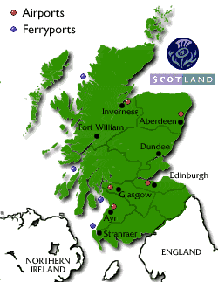
Setting
Macbeth is set in the 11th Century in Scotland
Important places in the play: Forres, Inverness, Dunsinane
When the play opens, Scotland has been invaded by Norway and is fighting back.

Slide 5
Act One
Scene One

Slide 6
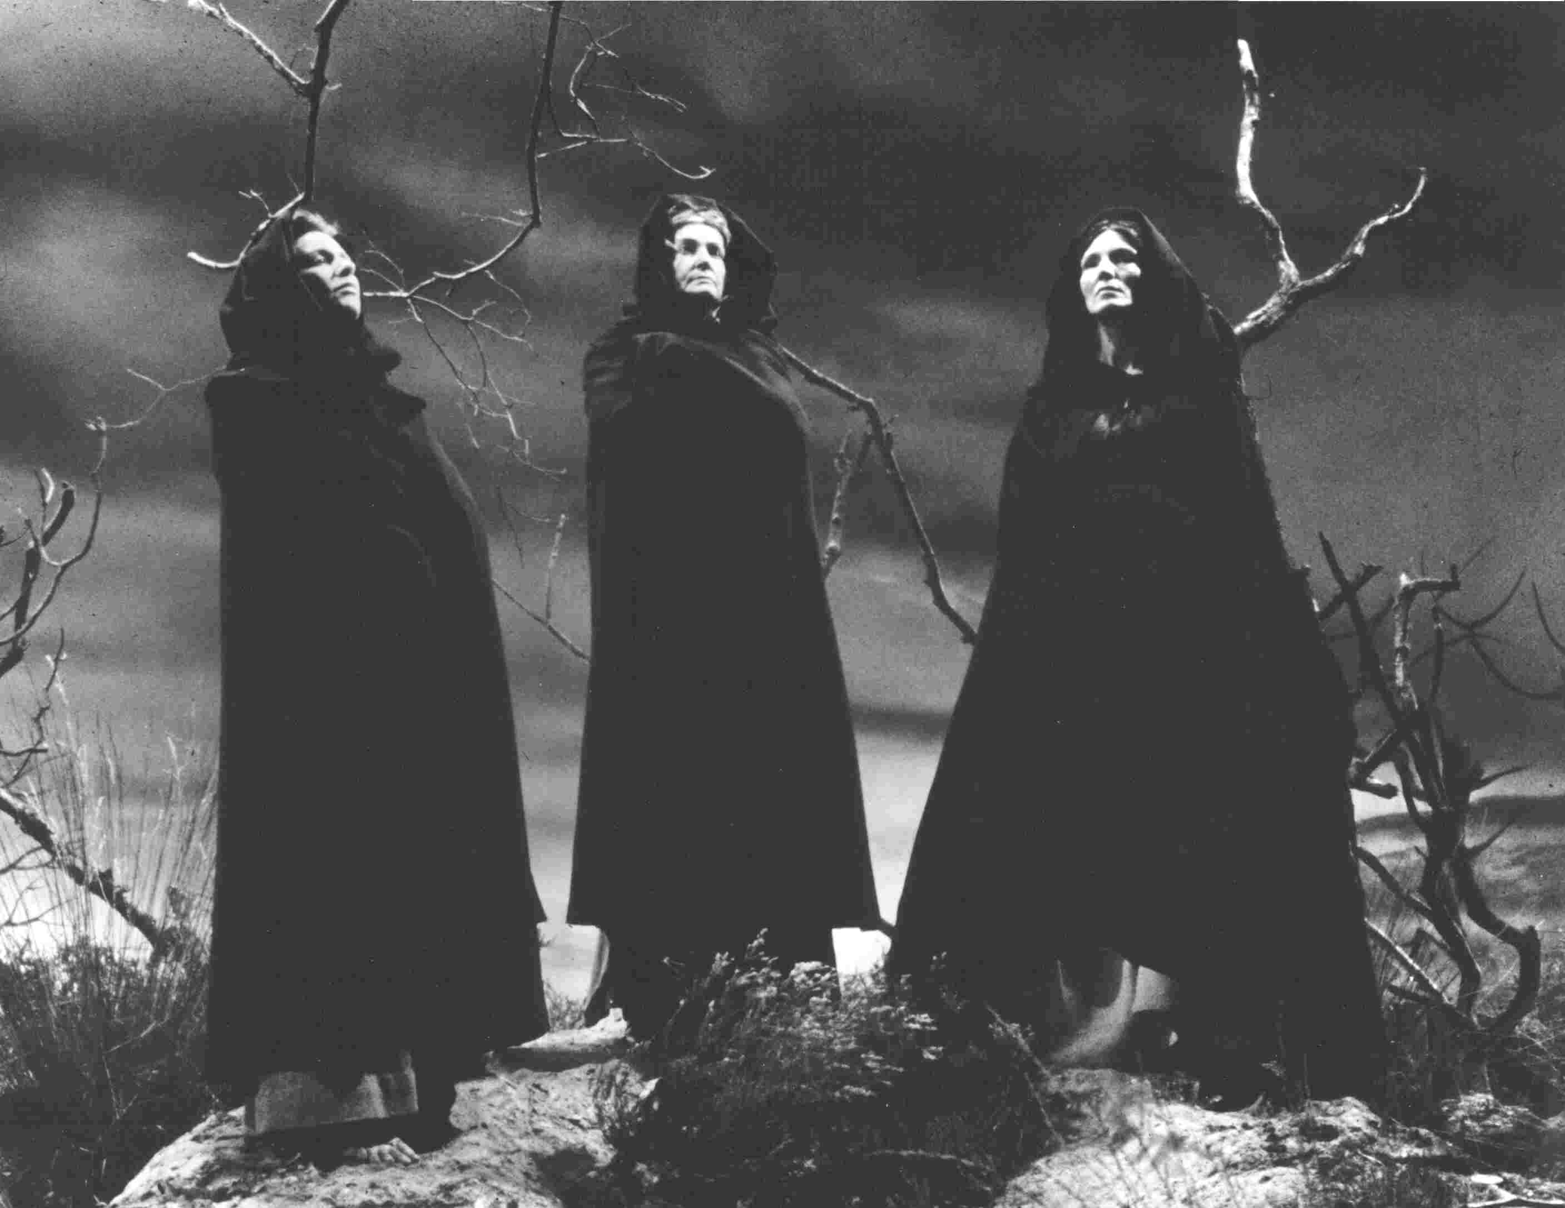
On a lonely Scottish heath, three ugly, old women—witches—appear amidst crashing thunder and lightning.

Slide 7
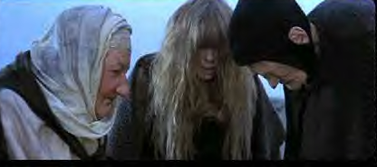
You may not believe in witches, but the typical Elizabethan did. King James not only believed in them, he had written books and articles about witchcraft.

Slide 8
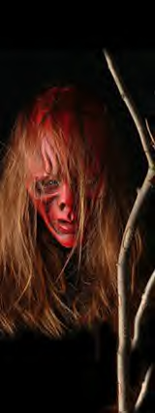
Things Elizabethans Believed About Witches:
They could turn themselves into any animal, but the animal wouldn’t have a tail, since humans don’t have tails.
Witches could control the winds.
They could travel over water in a sieve.
The had familiar spirits (animals who helped them communicate with the devil).
Witches like to kill pigs.

Slide 9
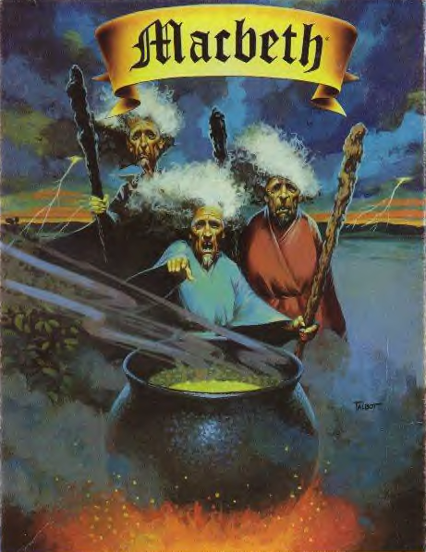
The witches make plans to meet again upon the heath, after the battle, to confront Macbeth. As quickly as they arrive, they disappear.

Slide 10
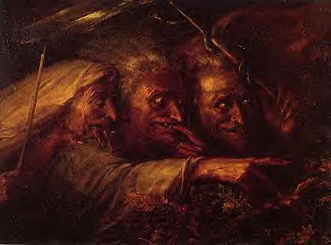
The first witch has a cat for a familiar spirit—Graymalkin.
The second witch’s familiar spirit is a toad named Paddock.
We find out the name of the third witch’s familiar spirit later on—Harpier—but we never find out what kind of animal Harpier is.

Slide 11
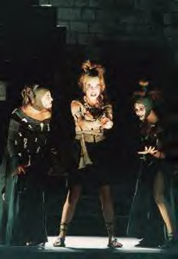
The purpose of this short scene is to set the mood or tone of the play.
It will be a scary play, full of mystery, murder, mayhem, gore, and blood.
The appearance of witches at the beginning of the play lets the audience know this will be the Elizabethan equivalent of a horror movie.

Slide 12
Act One
Scene Two

Slide 13
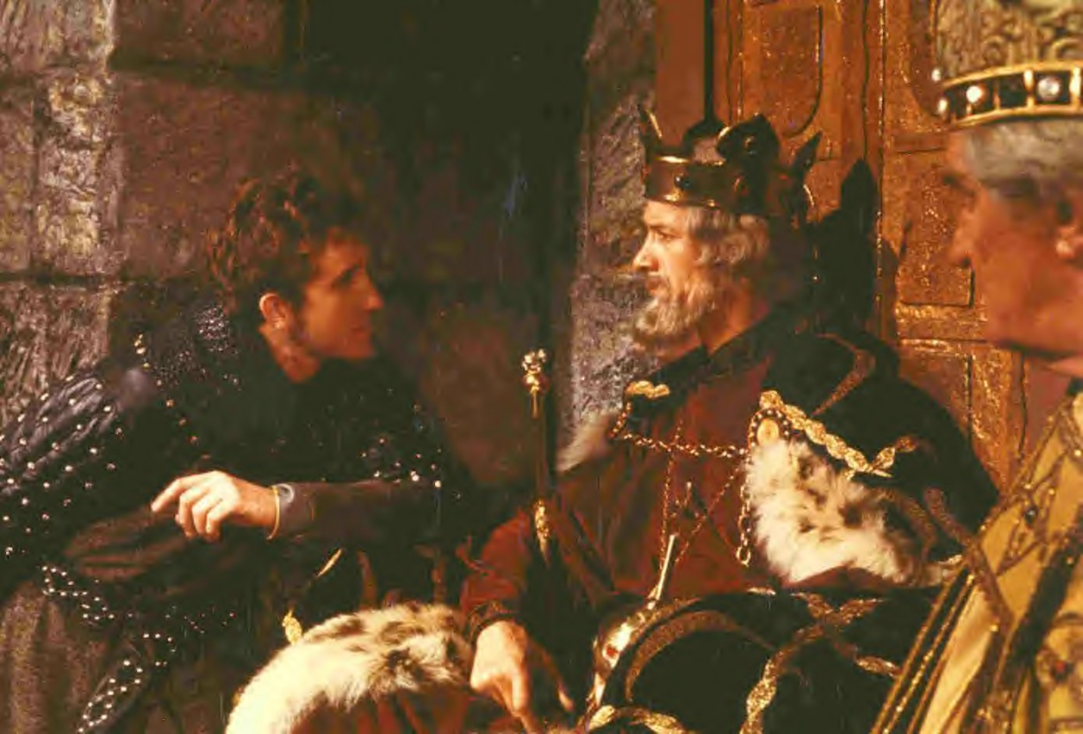
Near Forres,
location of
King Duncan’s
palace, Duncan
is waiting for
word from the
battlefield as
to how the war against Norway is going. Duncan’s
older son, Malcolm, sees a wounded officer fresh
from the battlefield and asks him how things stood.
The officer tells him it was a toss-up between
Norway and Scotland, except for the actions of
Macbeth, Duncan’s cousin.

Slide 14
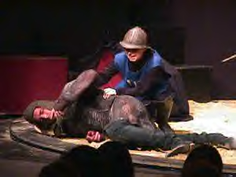
The wounded officer (“sergeant” meant “officer”) tells Malcolm and the King that Macbeth is a great hero, having killed a traitor named Macdonwald by gutting him with one stroke of the sword.

Slide 15
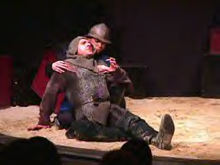
Macbeth then cut off Macdonwald’s head and put it on a pike for his men to see. Macbeth almost single-handedly is winning the war for Scotland. He and Banquo are the great heroes of this war.

Slide 16
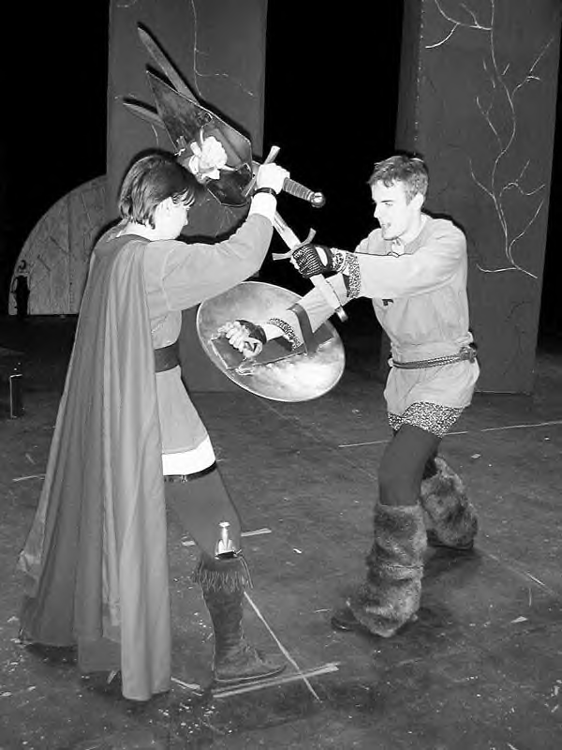
Macbeth and Banquo are unafraid even though they are outnumbered and tired.
They are no more afraid of the enemy than an eagle would be afraid of a sparrow or a lion would be afraid of a rabbit.

Slide 17
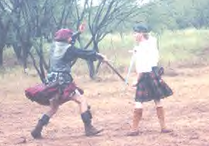
Macbeth and Banquo fought so hard they resembled cannons loaded with double charges.
They seemed to be wanting to bathe in the blood of their enemies, or to recreate Golgotha, the place where Chris was crucified.
At last, the wounded sergeant says he must have doctors, and King Duncan and Malcolm send him to the doctors to take care of his wounds.

Slide 18
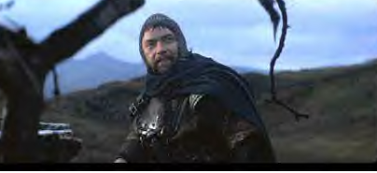
One of the problems with this war is that several Scottish noblemen (thanes) had turned traitor against Duncan. Macdonwald, who Macbeth killed in face-to-face combat was one of them. Another, the old Thane of Cawdor, had turned traitor against
King Duncan.

Slide 19
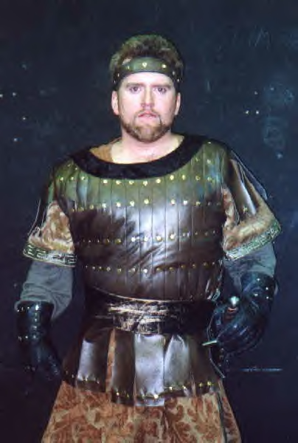
Ross, a thane, enters and tells the King that he has come from Fife, where Macbeth has won yet another battle for Scotland (an impressive feat, since Fife is over 200 miles from where Macbeth was last reported to be).
The old Thane of Cawdor had turned traitor against Duncan, but he has been captured alive.
Sweno, king of Norway, concedes defeat and is being held off the coast of Edinburgh. He has agreed to pay $10,000 to Scotland as compensation for the damages done during this invasion.
The war is over, thanks in large part to Macbeth!

Slide 20
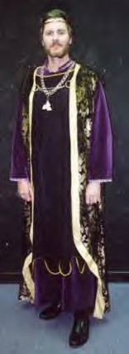
King Duncan orders that the old Thane of Cawdor be executed, and his title be stripped from him and given to Macbeth in partial reward for his great deeds in battle.
The King comments that the Thane of Cawdor shall no longer deceive him.

Slide 21
Mini-Themes of Macbeth
False Faces
Bloody Hands
Under the Cover of Darkness
Borrowed Clothes
“Let’s Talk It Over”

Slide 22
Act One
Scene Three

Slide 23
Back on the heath, the three witches (“Weird Sisters”) meet again. As they ask each other where they have been since they last met, one witch says she was killing pigs (a favorite pastime of witches).

Slide 24
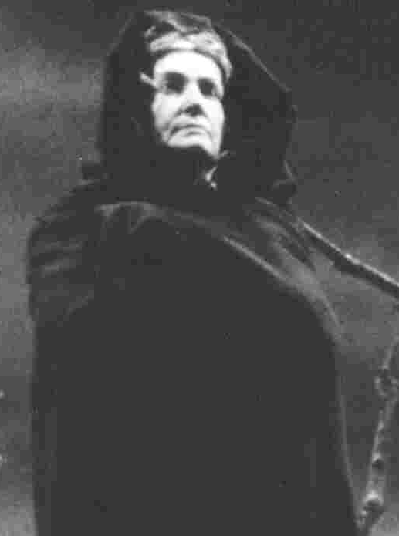
One witch says that she found a sailor’s wife eating chestnuts. The witch asked for some. The sailor’s wife told her to go away. The witch is going to punish the sailor’s wife by causing a terrible storm (81 weeks long) to toss her husband’s ship so badly he won’t be able to eat or sleep, until he just wastes away.
One witch offers her a wind to help her with the storm, the other offers another wind, and she says she has control of the other two winds.
Finally, she shows the other two her latest prized possession: the thumb of a ship’s pilot who was wrecked on his way home.

Slide 25
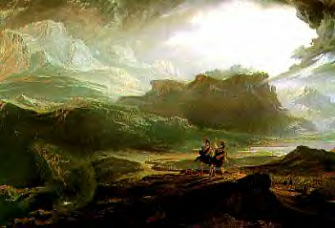
The witches hear a drum, which means Macbeth is coming. Macbeth and Banquo are passing through the heath on their way to King Duncan’s palace at Forres.

Slide 26
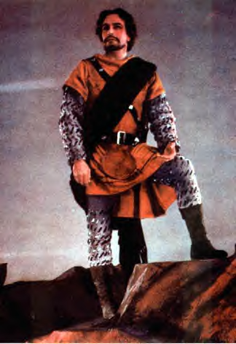
Macbeth says he’s never seen so foul and fair a day. It’s a foul day because it’s storming. It’s a fair day because they’ve won the war! They’re heroes!
Banquo wants to know how far it is to Forres.
Suddenly, they both see the witches.

Slide 27
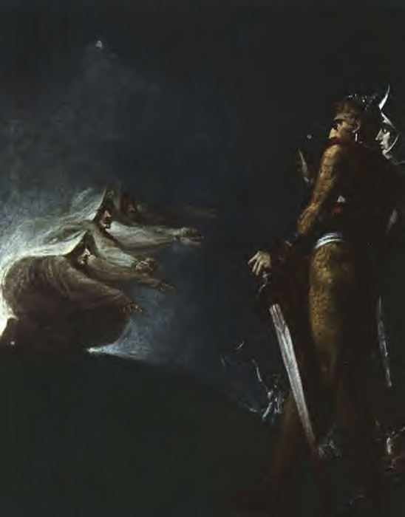
The witches are so ugly, Macbeth and Banquo aren’t sure they are even human. The witches have the forms of women, yet they have facial hair, which makes one wonder exactly what gender these creatures are.
They ask the witches if they can speak.

Slide 28
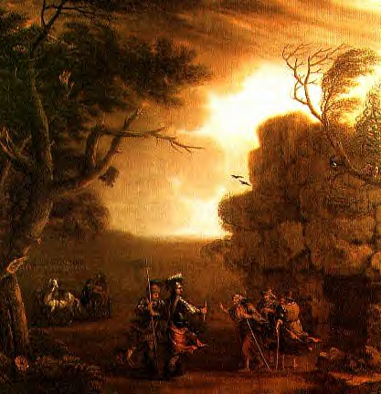
The witches greet Macbeth first, saying: “Hail, Thane of Glamis!”
“Hail, Thane of Cawdor!”
“Hail to thee who shalt be King hereafter!”
Macbeth is stunned by this greeting. He already is Thane of Glamis…he has been ever since his father, Sinel, died.

Slide 29
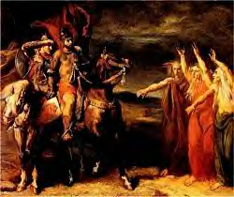
Macbeth doesn’t know it yet, but he’s already Thane of Cawdor, too, because the old Thane is being executed and the title given to him. So right now, it’s a prediction.
The idea of him becoming king just doesn’t make sense.

Slide 30
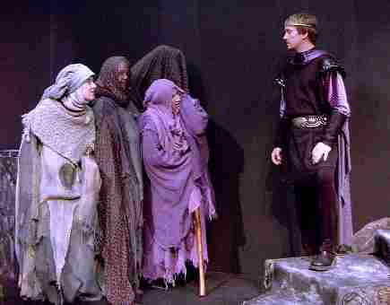
Macbeth asks the witches where they got this information, but but they don’t answer him. Dazed, Macbeth seems lost in thought.
Banquo asks the witches to tell him his future, too.

Slide 31
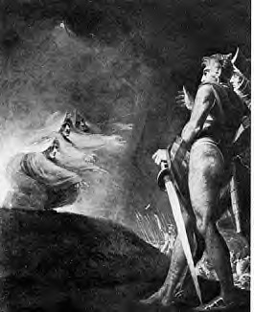
The witches tell Banquo that he is lesser than Macbeth, but greater.
He will be less fortunate than Macbeth, but more fortunate.
Though he shall not be king himself, Banquo shall be the father to a line of kings.

Slide 32
Macbeth tries to get the witches to stay and tell him more information and explain how they got this information they had shared.
The witches disappear quickly (down the trap door).
Macbeth and Banquo wonder if the witches had even been there, or if it was a hallucination.
Banquo asks if they had “eaten of the insane root that takes reason prisoner” (the root of the henbane, or hemlock, plant, a hallucinogenic).

Slide 33
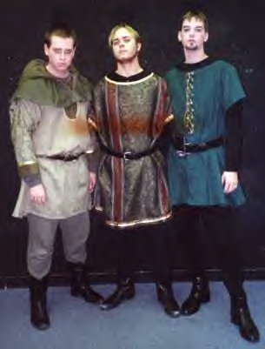
As Macbeth and Banquo discuss the witches, Ross and Angus arrive to lead them on to Forres, where the king awaits them.
The king plans to reward them for their service to Scotland in the war.

Slide 34
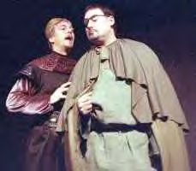
They tell Macbeth that the king has just made him Thane of Cawdor. Macbeth wants to know how this could be.
They explain that the old Thane was a traitor and is being executed, and now Macbeth has the title.

Slide 35
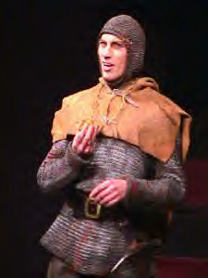
Macbeth and Banquo are both shocked by the suddenness with which one of the witches’ prophecies had come true.
Banquo doesn’t want to trust too much in the supernatural knowledge of the witches.
They all go on their way to Forres Palace.

Slide 36
Act One
Scene Four

Slide 37
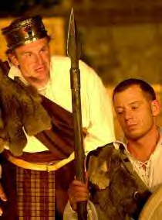
At Forres, the King wants to know if the old Thane of Cawdor has been executed yet, and Malcolm tells him of how the Thane confessed and went nobly to his execution, as if giving up something that was not important to him. Dying was the most noble thing the old Thane of Cawdor ever did.

Slide 38
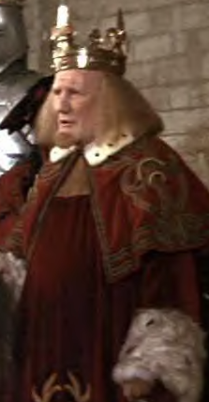
Duncan says that there’s no way to tell what’s in a man’s mind or heart by seeing what’s on his face; he had trusted the old Thane of Cawdor.
Ironically, just as he says this, Macbeth, the new Thane of Cawdor, enters.
Duncan welcomes Macbeth and Banquo and promises them great rewards in the coming days.

Slide 39
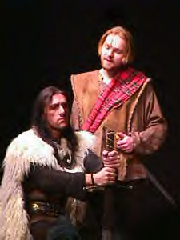
Macbeth and Banquo thank the king, saying they were just doing their duty.
Duncan says he’s happy to have his country’s greatest noblemen and his own best friends and family present under one roof, and he wants to make an announcement.

Slide 40
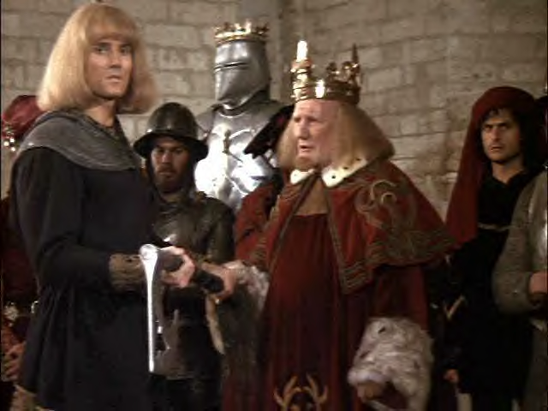
King Duncan announces that his older son, Malcolm, now has the title Prince of Cumberland, which means he will take the throne when Duncan dies.

Slide 41
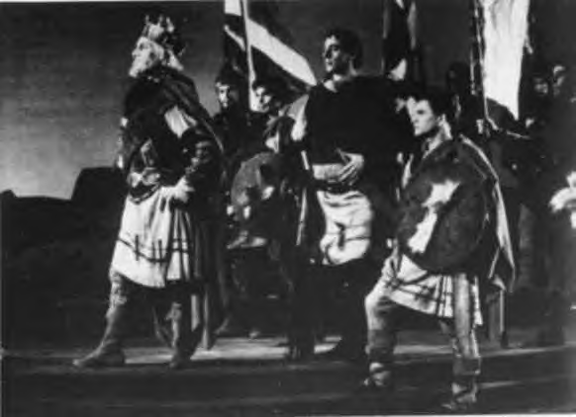
This is not good news for Macbeth, because he wants to become king after Duncan dies. He sees this new development as an obstacle in his way.

Slide 42
Duncan tells Macbeth that they are all going to his home, Inverness, to spend the night.
Macbeth says there is much work to do to prepare for the king’s arrival, and he asks permission to race home ahead of the group to help his wife prepare.
As he leaves, Macbeth says to himself that he wants the stars to hide their fires so that light cannot see his dark and deep desires.

Slide 43
Almost as soon as Macbeth has left, Duncan, admiring his cousin, decides they should all chase and catch up with Macbeth so they can all ride into Inverness together. They won’t manage to catch up to Macbeth, though.

Slide 44
Act One
Scene Five

Slide 45
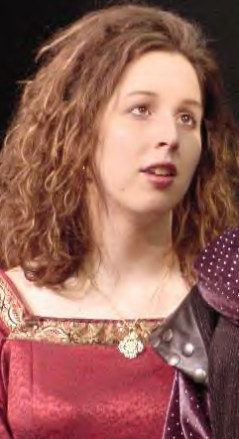
Lady Macbeth has received a letter from her husband, telling her of the witches’ appearance and prophecies and how he has already become Thane of Cawdor.
She LOVES the idea of becoming Queen.
She is afraid her husband lacks the guts to murder people in order to become king the quickest way possible.

Slide 46
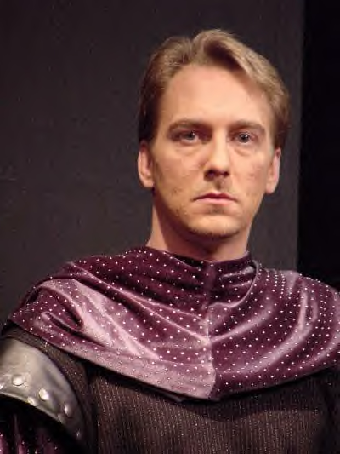
Lady Macbeth believes her husband wants to be king, but would probably wait for it to come to him in its own good time rather than doing anything shady and devious to win the crown.
She wishes her husband were present so she could pour her spirits into him (talk him into murder).

Slide 47
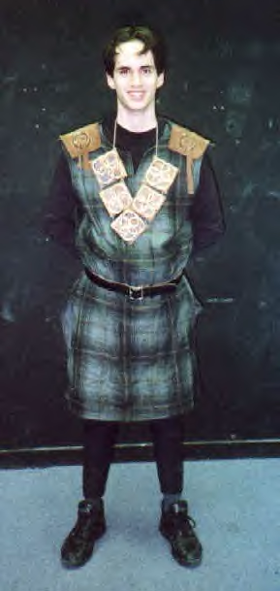
A messenger comes to tell Lady Macbeth that the King is coming to spend the night at Inverness. Macbeth has just arrived at the castle and will be with her shortly.
Lady Macbeth is delighted the King will be there; this is her opportunity to kill him so that her husband can become King.

Slide 48
Lady Macbeth prays an unholy prayer to demons, asking them to “unsex” her (take away all womanly weaknesses and make her more man-like—brave, courageous, no remorse or guilt or conscience).
She also prays for a dark, dark night (she wants the thickest smoke of hell to come up and make the night even darker so that no light will see her sharp knife).

Slide 49
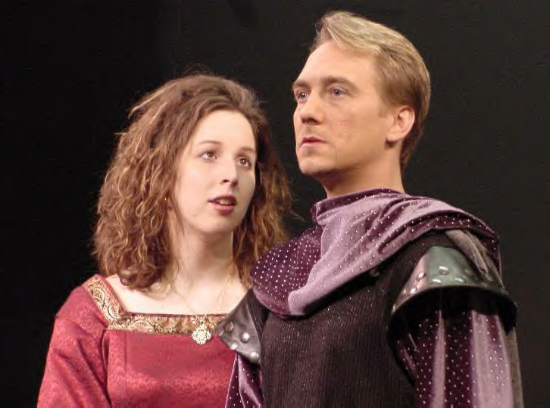
Macbeth arrives, and Lady Macbeth begins to lay out her plan for killing the King. She tells her husband to leave everything to her; she’ll take care of things herself. She warns Macbeth, however, that his face easily reveals his emotions, and he must be cautious to put on a happy, carefree face tonight while the King and other guests are present.

Slide 50
Act One
Scene Six

Slide 51
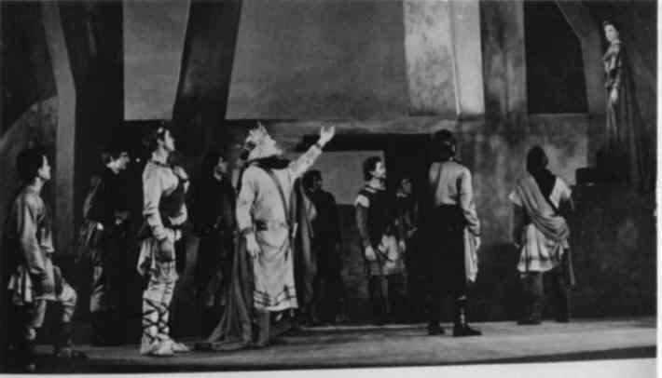
Duncan and his entourage arrive at Inverness.
They remark on how calm and peaceful this place is.
Some birds—martins (a slang term for someone easily fooled) are building nests in the stone walls of the castle.

Slide 52
Lady Macbeth appears to greet the King and her guests.
Duncan thanks her for the trouble she’ll go to in making their stay a pleasant one.
The King asks Lady Macbeth to take him to her husband, adding that he loves Macbeth greatly.

Slide 53
Act One
Scene Seven

Slide 54
Later that evening, Macbeth has left a big feast in honor of King Duncan so that he can have time to think over what he and his wife are planning to do.
Macbeth has decided not to kill the King.

Slide 55
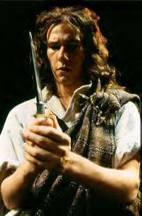
Macbeth is worried about his soul. He’ll be damned to hell if he kills the King. Also, what if their plan fails? Sometimes devilish plots backfire and hurt the conspirator rather than the victim.

Slide 56
Macbeth has four good reasons for not killing the King:
First, Duncan is his kinsman, his cousin.
Second, Duncan is his guest; he should prevent a guest’s murder, not handle the knife himself.

Slide 57
Third, Duncan is his King. It was an act against nature and against God to kill God’s chosen one, the King.
Fourth, Duncan has been a good King. He doesn’t deserve this!
Macbeth is afraid if he kills the King, little naked cherubs will fly down from heaven, crying, and pointing out the dastardly murder Macbeth committed.

Slide 58
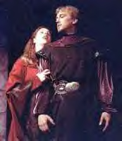
Lady Macbeth comes out to chastise her husband for leaving the banquet. If the guests miss him, they’ll wonder about it later, after the King’s murder is discovered.
Macbeth tells his wife that he’s changed his mind—they will not kill Duncan.

Slide 59
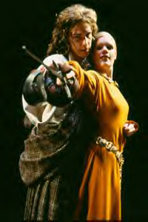
He tells his wife that Duncan has rewarded him of late, and here lately people have a new respect for him—he’s a HERO!—he should enjoy these new honors for a while rather than trying to kill the king in an attempt to gain even more glory and a higher position.

Slide 60
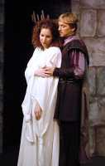
Lady Macbeth sees her husband backing down from their plan, and she pushes him, using dirty, little womanly tricks:
She challenges his manhood.
She tells him it was his idea in the first place!
She questions his love for her.

Slide 61
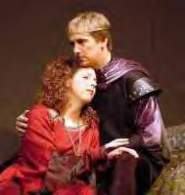
She tells him that she has known the love of a mother for a small baby nursing at her breast, but if it took it to become queen, she would gladly pluck the baby’s mouth from her breast and bash its brains out. Macbeth is stunned by her passion.

Slide 62
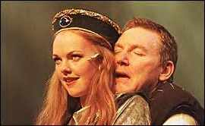
“What if we fail?” he wants to know. She tells him to screw his courage to the sticking place (an allusion to crossbows) and they won’t fail.

Slide 63
Lady Macbeth reviews the plan with him:
Duncan will soon go to bed and fall asleep.
Two guards will be in his room—she’ll drug them to make them sleep.
As the guards sleep, they will be able to kill Duncan.
When the body is discovered the next morning, no one will suspect them because they will appear more upset than anyone.

Slide 64
Macbeth finally agrees to the plan.
In the meantime, they must go back to the party and put on happy faces. “False face must hide what the false heart doth know.”

