Slide 1
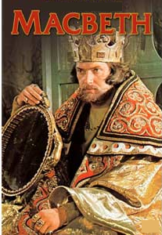
Act Two
Scene One

Slide 2
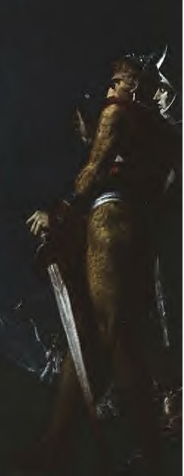
Later that night at the castle, Banquo and his son Fleance are walking about the castle grounds.
It’s late—sometime past midnight.
It’s dark—Banquo says, “There’s husbandry in heaven, their candles are out.” There are no stars out, and the moon has gone down.
They seem to be undressing for bed as they walk; Banquo hands two items to Fleance, presumably his belt and sword.
Banquo says he’s really, really tired, but he can’t sleep because of a burden on him.

Slide 3
Macbeth and a servant approach with a torch.
Banquo asks, “Who goes there?” and Macbeth replies, “A friend.”
Banquo is surprised Macbeth isn’t in bed already. He says that the king is in bed. The king has enjoyed himself at Inverness.
Macbeth says he and his wife did their best to show the king a good time, but they were unprepared because of the suddenness of the visit.
Banquo says the king has given loads of money to Macbeth’s servants and a huge diamond to Lady Macbeth as a gift for being such a good hostess.

Slide 4
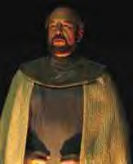
Banquo tells Macbeth that he dreamt last night of the three weird sisters—part of what they predicted to Macbeth has already come true.
Macbeth lies, saying that he thinks nothing of the witches.
But, Macbeth says, when we have the time to get together and talk over what has happened, let’s do it!

Slide 5
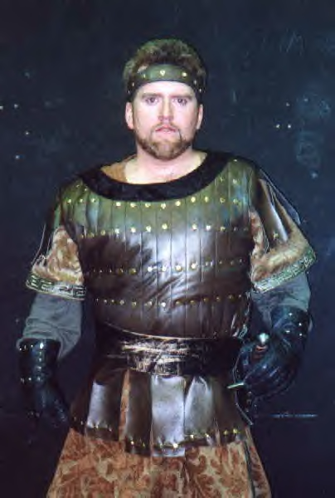
Banquo agrees to get together with Macbeth to talk, and Macbeth tells him in a round-about way that, if when the time is right Banquo sides with Macbeth, he will be glad he did.
Banquo lets Macbeth know that he is Macbeth’s friend, but that he will do nothing that will besmirch his reputation or put his honor in question. He’s strictly loyal to King Duncan.
Banquo and Fleance go to bed.
Macbeth tells his servant to go tell Lady Macbeth to get his nightcap ready and ring the bell to summon him when it’s ready. (The bell is actually to let him know the coast is clear, the guards asleep, and it’s time to kill King Duncan).

Slide 6
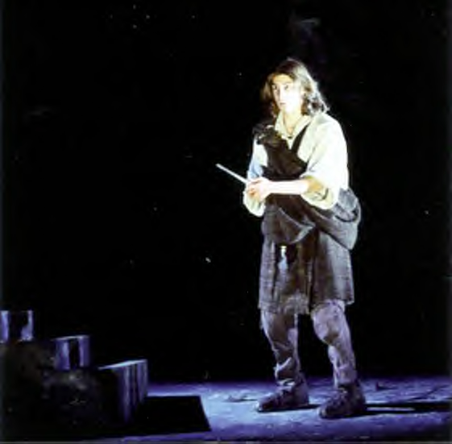
Left alone, Macbeth sees a vision of a dagger floating in the air in front of him. He tries to touch it, but can’t. It reappears, and seems to guide him in the direction of Duncan’s room, like a omen or sign. Macbeth intends to use a dagger to kill Duncan. The dagger appears again, this time covered in blood and gore. Realizing this is a hallucination caused by his nerves, Macbeth thinks instead about how evil runs loose during the night. The world (a half-world because half of it is covered in darkness at any moment of the day) sees more sin and crime and evil done in darkness than in light. He is ready to murder Duncan as soon as he hears the bell.

Slide 7
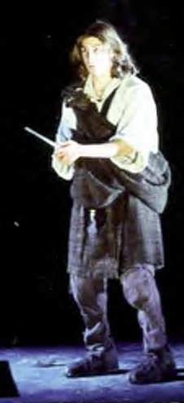
At last, Macbeth hears the bell. He says, “Hear it not, Duncan, for it is a knell that summons thee to heaven…or to hell.”
A knell is a bell tolled at a person’s death to announce the death.
Macbeth goes up to kill the king.

Slide 8
Act Two
Scene Two

Slide 9
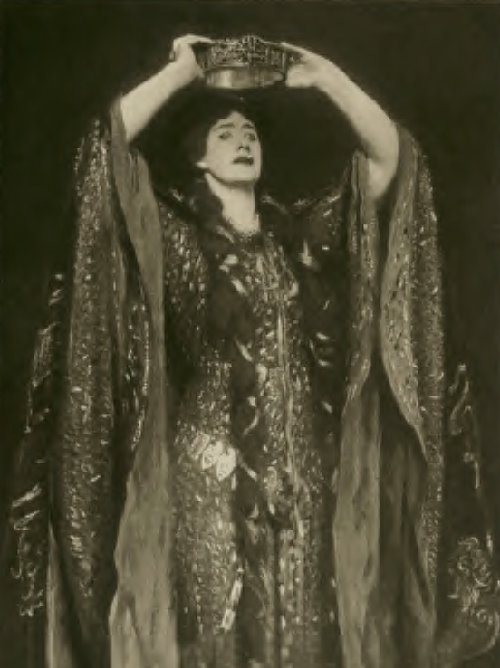
Lady Macbeth is waiting for her husband to finish killing Duncan. She wonders why it’s taking so long.
She drugged the guards and waited till they were asleep. She laid out their daggers for him to use.
Lady Macbeth says she would have killed Duncan herself, if he hadn’t looked like her father as he lay there sleeping.

Slide 10
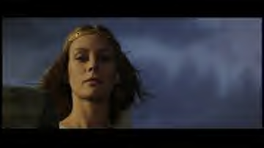
Lady Macbeth is worried, because it’s taking her husband too long to kill Duncan. It should be fast—everything was ready! She is nervous.

Slide 11
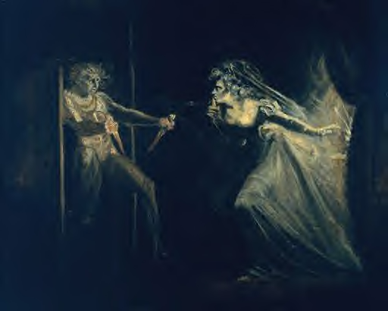
She hears noises (owls, crickets). She’s afraid they’ll be caught in the act. She hears her husband’s voice, then Macbeth comes down the stairs. He says, “I have done the deed.”

Slide 12
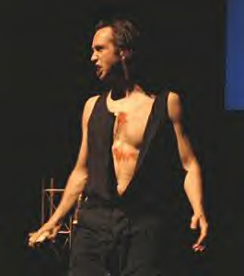
Macbeth has blood on his hands, and he’s carrying the two daggers (a mistake).
He says, “This is a sorry sight!” referring to the blood on his hands.
Lady Macbeth tells him it’s a foolish thing to say that it’s a sorry sight.

Slide 13
He wants to know who was in the bedroom next to Duncan’s.
Lady Macbeth says Donalbain and Malcolm shared that bedroom.

Slide 14
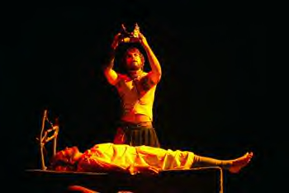
Macbeth says that as he was killing Duncan, the two men in the next room awakened, one laughing and one yelling, “Murder!” They said their prayers and then went back to sleep.

Slide 15
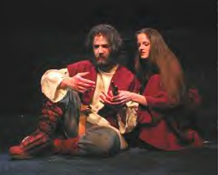
As he listened to them, Macbeth tried to say “Amen” when they said “Amen.” But the word stuck in his throat. He wants to know why he couldn’t say it.

Slide 16
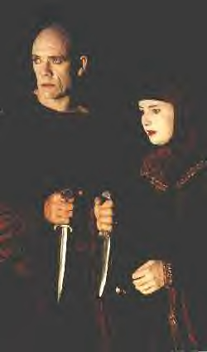
Lady Macbeth tells her husband not to think anything about it—it will make him crazy. But he continues to talk about it. He also thought he heard someone yelling upstairs, “Wake up! Macbeth is murdering sleep.” Macbeth talks about how beneficial sleep is, calling it by seven different terms. Macbeth believes that he heard somebody yelling “Macbeth shall sleep no more.”

Slide 17
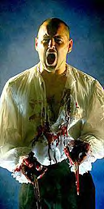
Lady Macbeth tells him this is all his imagination. In truth, Macbeth will NOT sleep peacefully again, from this moment forward. His guilt leads to terrible nightmares that prevent him from sleeping, and he appears more and more haggard with each subsequent scene, thanks to a lack of sleep.

Slide 18
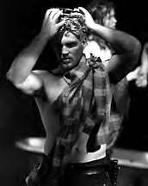
Still, Macbeth is worried about what he has just done.
Lady Macbeth notices he still has the daggers, and she tells him to take them back up and leave them, and to smear some blood on the faces of the guards so it will appear they killed Duncan.

Slide 19
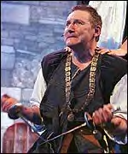
Macbeth says that he doesn’t want to even think about what he has done, let alone look at it again. He refuses to take the daggers back up to the king’s room.

Slide 20
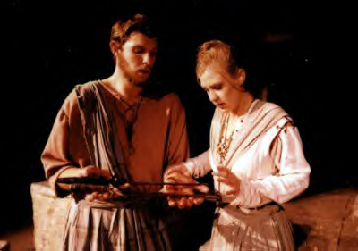
Lady Macbeth chastises her husband for being so cowardly. She tells him that the dead and sleeping can do him no harm.

Slide 21
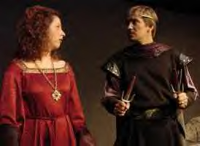
Lady Macbeth takes the daggers from her husband and tells him that she’ll do it—she’ll take the daggers back. If Duncan is still bleeding, she’ll scoop up some blood and smear it on the guards’ faces.

Slide 22
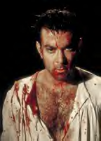
Suddenly, there is a knocking at the south entrance to the castle. Macbeth is startled by the noise. Macbeth looks at his hands, covered in blood, and wonders if there’s enough water in all great Neptune’s oceans to wash the blood from his hands. He decides that if he stuck his hands into the water, they would turn the green water red.

Slide 23
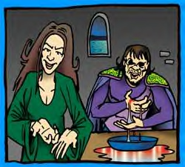

Slide 24
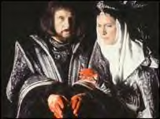
Lady Macbeth comes back in time to hear this, and she again chastises her husband for being a coward.

Slide 25
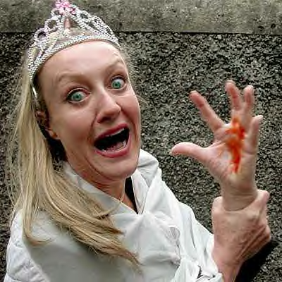
She says that her hands are the same color as his, but she’d be ashamed to wear a heart so white.

Slide 26
Lady Macbeth says that someone is knocking at the gate, and they need to get into their bedroom and wash up and change into their nightclothes before they are discovered. She tells him that this is no big deal—a little water will clear them of this deed. Macbeth seems stunned, dazed, awed. She pushes him into action, and they head back to their bedroom. Macbeth says, “Wake Duncan with thy knocking! I wish thou couldst.” He already regrets having murdered the king.

Slide 27
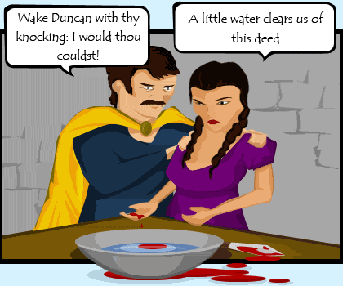

Slide 28
Act Two
Scene Three

Slide 29
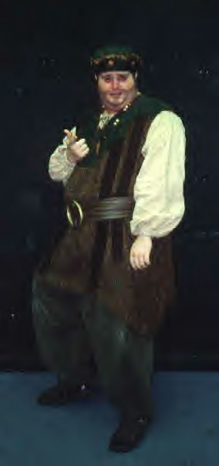
A drunk porter stumbles across the room to open the door. He pretends to be the gatekeeper of hell.
He imagines three scenarios of individuals who would come to hell:
A farmer who hanged himself when his bumper crop became valueless as prices went down,
An equivocator (liar) who would testify to a lie for either the defendant or the prosecution,
An English tailor caught stealing material for making French hose.
The porter decides it’s too cold to be hell, just as he reaches the door and opens it to admit Macduff and Lennox.

Slide 30
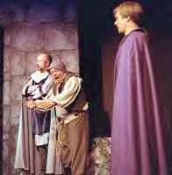
Macduff and Lennox have come to get King Duncan, as he had ordered them. They are almost late. Macduff exchanges funny and dirty witticisms with the drunk Porter, both men getting fairly vulgar. This is comic relief…Shakespeare is relieving the tension from that last, grisly scene, with humor.

Slide 31
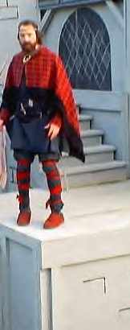
Just as Macduff asks if Macbeth is awake yet, Macbeth comes down, as if he had just awakened and bids them good morning.
Macduff tells Macbeth he is supposed to get the king so they can continue on their journey today.
Macbeth takes Macduff to the door that will take him to the king’s room.
While they wait, Macbeth and Lennox talk about the terrible storm that occurred that night—thunder, lightning, earth tremors, wind, and owls clamoring all night long.

Slide 32
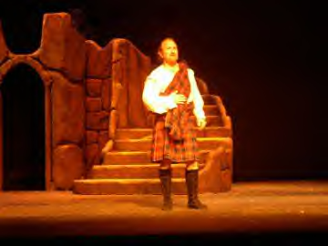
Macduff comes running back down screaming that the king has been killed. Macbeth pretends to be surprised…Lennox genuinely is. Macduff tells them to go see for themselves, to “feast your eyes on a new Gorgon,” or to petrify themselves with the sickening sight of the dead king. They both run up to the king’s room.
In the meantime, Macduff yells for the alarm bell to ring and yells for everyone to wake up and come down.

Slide 33
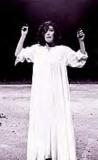
Lady Macbeth comes down first and asks what’s going on. Macduff refuses to tell her, saying such terrible news might kill her. Then Banquo joins them, and Macduff blurts out the news to him, even though Lady Macbeth is hearing the tragic news, as well. Banquo is shocked, and Lady Macbeth pretends to be shocked.

Slide 34
One by one, the thanes begin to come down from their bedrooms to see what the racket is about. Many are half-dressed, because they’ve been in bed. They are shocked to hear the news of the king’s murder.

Slide 35
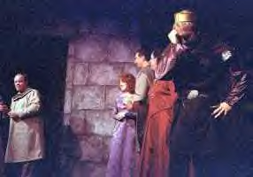
Macbeth and Lennox come back down from the king’s room. Macbeth says he wishes he had died an hour earlier, because now there’s nothing worth living for.
Malcolm and Donalbain enter and are told of their father’s death.

Slide 36
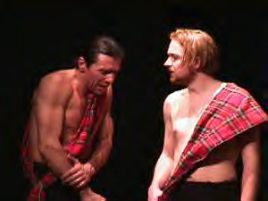
They are told that the guards in their father’s room appear to have killed him. Macbeth announces that he’s sorry that in a fit of rage, he killed those guards.

Slide 37
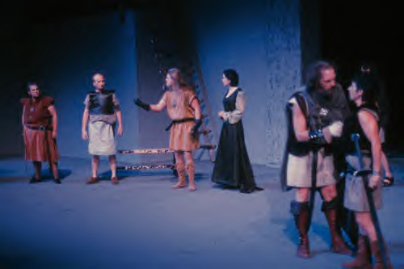
Macduff, suspicious from the first, asks Macbeth why he killed the guards. Macbeth replies that it was his love for and loyalty to Duncan that caused him to act on impulse and kill the villains before he’d had a chance to think reasonably.
Sensing unwanted attention and suspicious on her husband, Lady Macbeth diverts everyone’s attention to herself by fainting. Banquo requests someone take care of their hostess, and realizes they are all just half-dressed.

Slide 38
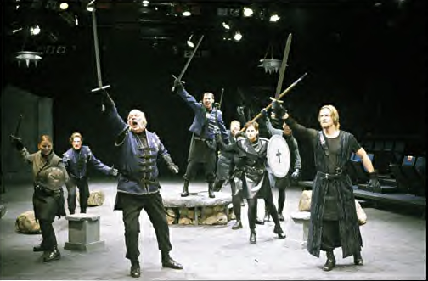
Banquo suggests they all get dressed…Macbeth agrees. They will meet back in the hall to discuss what has happened very soon. None of them will let this murder go without revenge.

Slide 39
Malcolm and Donalbain remain alone when the others leave. They realize whoever killed their father is most likely out to get them, too. They are unsafe here. They don’t know who to trust. They decide to separate.

Slide 40
Donalbain will go to Ireland. Malcolm will go to England. “The nearer in blood, the nearer bloody,” Donalbain says. By separating, they can only hope the murderer can’t get them both. They leave without telling anyone.

Slide 41
Act Two
Scene Four

Slide 42
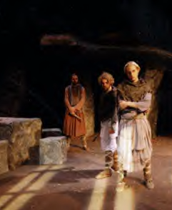
An old man talks to Lennox about the recent events. Because they ran off without saying goodbye to anyone, Malcolm and Donalbain are suspected of having hired the guards to kill their father and then gotten scared. Because they’re murder suspects, they can’t be king. So Macbeth has been named the new king.

Slide 43
The night Duncan was murdered, his two fine horses broke out of their stables and ate each other. This is another strange occurrence associated with the murder of the king.
Macbeth has gone to Scone to sit on the Stone of Scone in order to be crowned King of Scotland.
Duncan’s body has been taken to Colmekill, ancient burial place of Scottish kings.
Macduff refuses to go to Scone to see Macbeth crowned, an obvious sign he won’t accept Macbeth as king. Lennox decides to go to Scone to be loyal.

