Slide 1
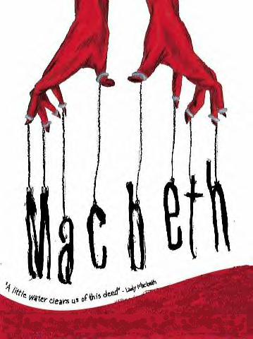
Act Three
Scene One

Slide 2
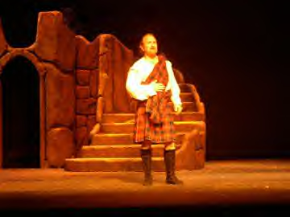
At Forres, Banquo suspects Macbeth of murdering King Duncan. However, he won’t be saying anything about it, because in the long run, Macbeth benefited Banquo’s children. The Witches predicted Banquo’s children would some day be kings of Scotland…so what Macbeth did probably will help to make that prophecy come true.

Slide 3
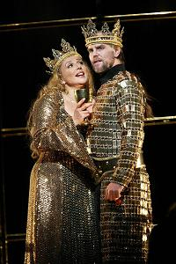
Macbeth, now king, and his wife greet Banquo as their “chief guest,” and Macbeth invites Banquo to a banquet he’s holding that night at 7 p.m.
Banquo and Fleance are going horseback riding today—just as far as they can go and still get back in time for Macbeth’s party. It will be an hour or two after dark before they get back, though.

Slide 4
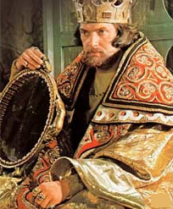
Macbeth says he would have liked to talk to Banquo this afternoon, but they can do that tomorrow. He adds that Donalbain and Malcolm have fled to Ireland and England and aren’t confessing to their murder of Duncan, but instead are telling people strange rumors about him!

Slide 5
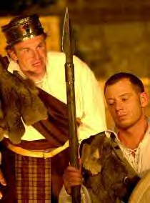
Macbeth wishes Banquo a good ride, reminding him to be back in time for the banquet, and Banquo leaves.
Macbeth tells everyone else to go do their own thing and leave him alone until the party begins so that he will enjoy their company all the more tonight.

Slide 6
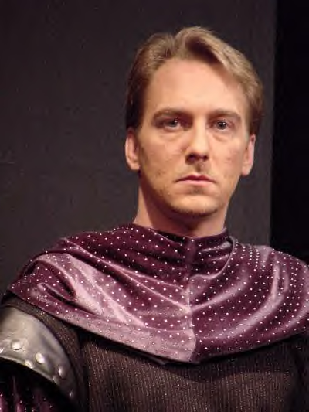
Macbeth tells a servant to go get a couple of guys who are waiting to see him.
While he’s waiting, Macbeth soliloquizes about how much he is afraid of Banquo—he thinks Banquo suspects him of having murdered Duncan.
To be king is a great thing, but Macbeth wants to SAFELY be king—no threats to his monarchy. He must kill Banquo!

Slide 7
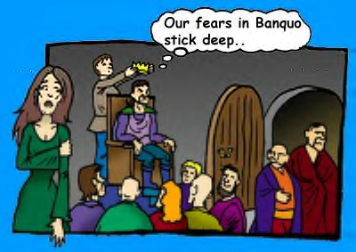

Slide 8
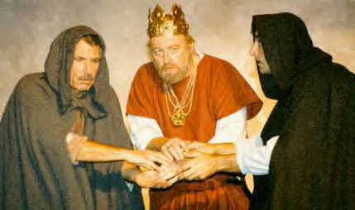
The two men—murderers—show up to talk to Macbeth. Macbeth had talked with these two guys on the previous day. At some point in the past, Macbeth has somehow hurt these guys—perhaps he held them back from promotion or he kept them from some kind of benefits. They have hated him for a while. Yesterday, however, he convinced these men that it was not he who had hurt them; it was Banquo! Banquo is their enemy!

Slide 9
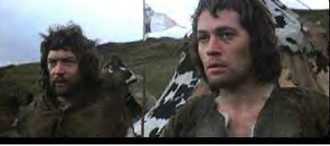
Macbeth asks the murderers what kind of men they are, and they insist they’re what he’s looking for. Macbeth talks about how all dogs are called “dogs,” but they are useful for different things, depending upon the breed. Macbeth needs brave men who seek revenge. They tell Macbeth they’re the guys he’s looking for.

Slide 10
Macbeth tells them that Banquo is HIS enemy, also. Macbeth has the power to execute or banish Banquo, but he doesn’t dare do so because he and Banquo share the same friends. Macbeth wants these two guys to murder Banquo, tonight, some distance from the castle, because there can be no hint that Macbeth had anything to do with it. Macbeth also wants Fleance, Banquo’s son, killed.

Slide 11
Act Three
Scene Two

Slide 12
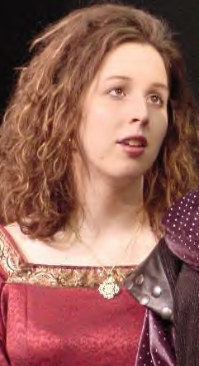
In another part of the castle, Lady Macbeth asks a servant if Banquo has left the castle yet, and is told that he has.
She asks the servant to get the King; she wants to talk to her husband.
Lady Macbeth is also happy to be queen, but wants there to be no threat to Macbeth’s monarchy.

Slide 13
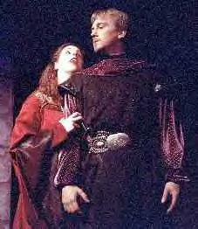
When Macbeth arrives, Lady Macbeth tells him that he made a mistake in giving everybody time off until 7 o’clock tonight. All he’s done has been to give people time to gossip about them behind their backs. There are people who suspect them, and they don’t need idle time on their hands. Also, it’s unusual for a king to want to be alone, as Macbeth seems to.
Macbeth tells his wife that he’d rather be dead—like Duncan—than to suffer the way he is.

Slide 14
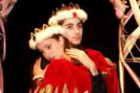
Macbeth says that he has not eaten a meal in peace since killing Duncan, nor has he had a peaceful night’s sleep—he is “shaken nightly” by terrible nightmares. Lady Macbeth tells him he needs to slick over his rugged looks—his lack of sleep is showing. Macbeth tells his wife to put on a happy face, as well, at the party tonight. He tells her to pay special attention to Banquo, flattering him. He tells her this even though he knows Banquo won’t be at the party, because he’ll be dead.

Slide 15
Macbeth says he’s tired of having to make his face a vizard (mask) to his heart, of flattering his enemies. He says they’re in danger as long as Banquo and Fleance are alive. Lady Macbeth tells him that they are only human—either of them could be killed.

Slide 16
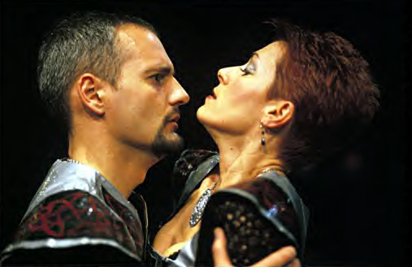
Macbeth tells his wife that before this night is over, a deed of dreadful note shall be done, but he doesn’t tell her exactly what it is. He says, “Be innocent of the knowledge, dearest chuck” (a term of endearment) until it happens, at which point she’ll know it was his doing and she’ll applaud it. This is the first time Macbeth isn’t completely open with his wife, who up until now has been his partner in crime.

Slide 17
Act Three
Scene Three

Slide 18
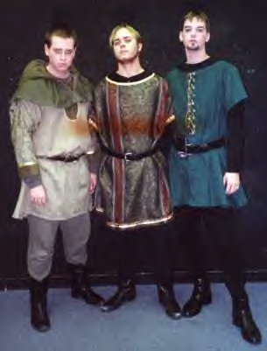
A third murderer has joined the first two murderers, who want to know who sent him.
They are mad that Macbeth sent him, because this is an indication that he does not trust them.
Nevertheless, they have the third murderer join them and wait for Banquo to arrive.

Slide 19
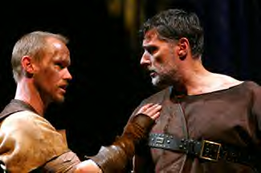
They hear the sound of voices—it must be Banquo and Fleance, because everyone else expected to arrive for the party has already arrived. As is custom at Forres, Banquo and his son leave their horses with the stablehands and will walk the last mile of the way to the palace. As Banquo enters, he says that it looks as if it will rain.

Slide 20
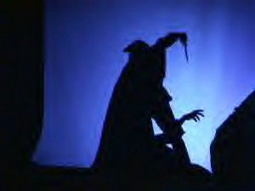
The murderers pounce down upon Banquo and begin stabbing him viciously. In the confusion, Fleance escapes as his father yells at him to run and save himself. When the ambush is over, Banquo is dead, his throat slashed and at least twenty stab wounds to the head, any one of which would kill him. When the murderers realize Fleance escaped, they realize that they must go tell Macbeth this bad news.

Slide 21
Act Three
Scene Four

Slide 22
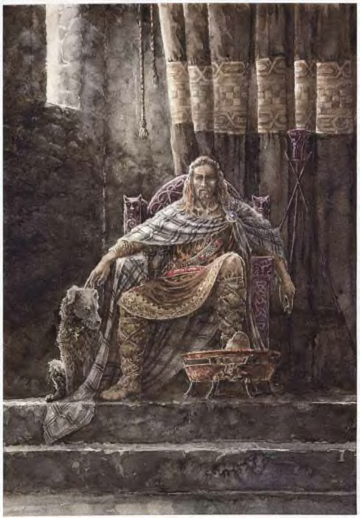
As Macbeth’s guests arrive at Forres for the banquet that night, he welcomes them and has them sit at the table as he mingles. Before he can offer the toast, he sees the first murderer at the door and goes to talk to him. The murderer has blood on his face, but it’s Banquo’s blood.

Slide 23
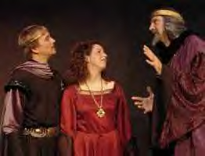
The murderer tells Macbeth that Banquo is dead, but Fleance escaped. Macbeth is displeased, but he accepts the situation. He sends the murderer away, promising to talk to him tomorrow.

Slide 24
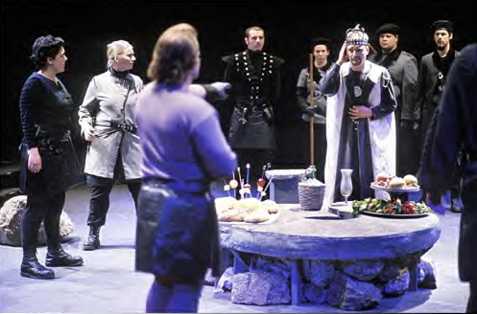
Lady Macbeth reminds her husband he has not offered his guests a toast, and so he makes a toast to them all, and he mentions that Banquo is missing…he hopes nothing has happened to Banquo. The thanes invite Macbeth to sit down with them

Slide 25
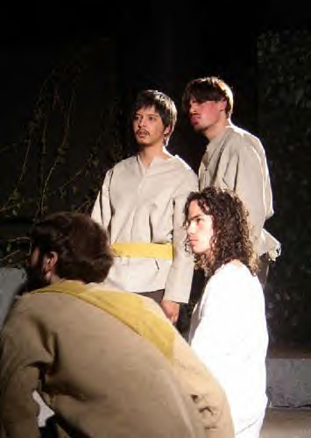
The bloody ghost of Banquo has entered the room. No one can see him except Macbeth. He does not speak. Macbeth does not notice the ghost at first. The ghost takes the only empty chair at the table, and as Macbeth scans the table, he sees no available seat, but he does not notice that it is a ghost occupying one of the stools.

Slide 26
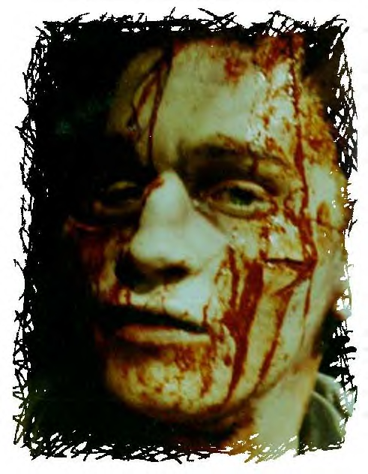
Macbeth seems to be solicitous of Banquo’s well-being, although some of the thanes say that Banquo should be ashamed of himself for not being present.
Again, Macbeth is urged to have a seat, and Lennox points out the empty seat. For the first time, Macbeth sees the bloody ghost of Banquo.

Slide 27
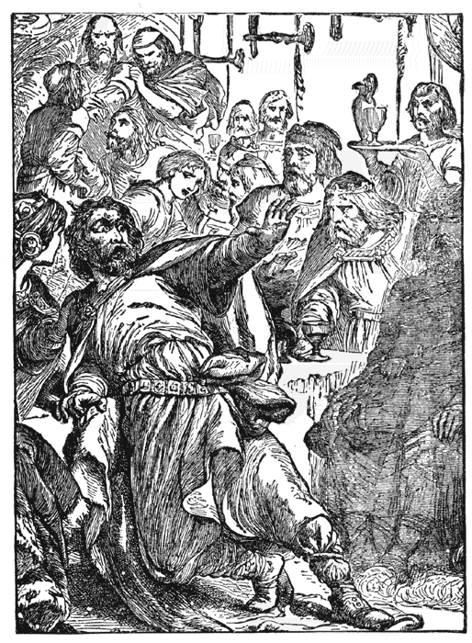
Macbeth is terrified of the ghost. He yells at it. He tells it not to shake his bloody head at him…he didn’t do it! He is innocent of the murder.
The other thanes stare in disbelief at their king. Is he crazy? He’s yelling in terror at an empty seat!

Slide 28
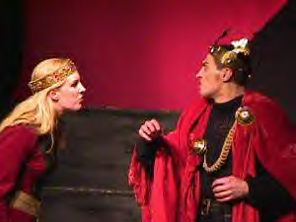
Lady Macbeth jumps up and tells the thanes to pay no attention to her husband…he has an illness (epilepsy)…has had it since he was a child. These fits come and go. He’ll be himself momentarily, and he’ll be embarrassed if they let on as if anything has happened. She pulls her husband aside and chastises him, asking what the trouble is.

Slide 29
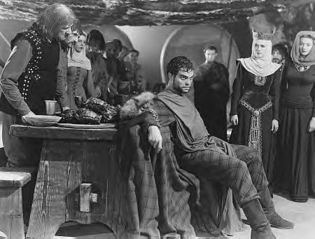
The ghost of Banquo leaves while Macbeth is talking to his wife, but he’s talking aloud of murders and blood and ghosts…all of which will make the Thanes wonder about Macbeth. She tries to quieten Macbeth, telling him this was all just his imagination, much like the dagger floating in the air that he had seen the night he killed Duncan. She warns him to pull himself together and get back to the business of the party.

Slide 30
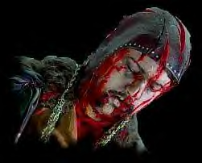
Macbeth explains to his guests about his illness and apologizes. He grabs some wine, and the ghost comes back in and takes the seat once more. Macbeth offers a toast to Banquo, saying, “I wish he were here!” Then he sees the ghost again, and he gets hysterical, yelling and screaming once more.

Slide 31
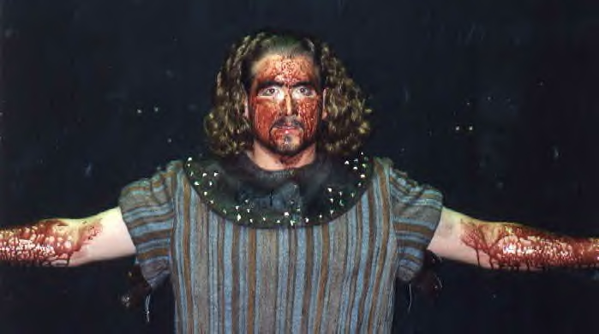
Macbeth challenges the ghost. He tells it to come back as anything—a rhinoceros, tiger, bear, or even be alive again and challenge him to a duel, and he’ll fight him. But he doesn’t want to face Banquo as a ghost. Again, Lady Macbeth pulls her husband aside and chastises him, and Macbeth asks her how can she look upon such a hideous sight and not be terrified herself.

Slide 32
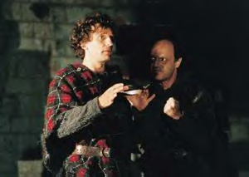
The thanes want to know what sight Macbeth is talking about, and Lady Macbeth realizes they’ve heard too much. She insists that they all leave, immediately. They wish Macbeth a good evening and better health.

Slide 33
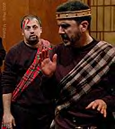
Macbeth tells his wife that blood will have blood. Murderers have been found out in strange, supernatural ways in the past, but this is really weird!

Slide 34
Macbeth asks his wife what time it is, and she said it is almost morning. He asks her what she thinks of the fact that Macduff did not come to his party, even though he had been invited. Macbeth decides he will find out what’s up with Macduff tomorrow. He has paid spies planted in the households of every thane in Scotland, so he has a way of finding out what they are thinking and talking about in their own homes.

Slide 35
Macbeth also says that he will go tomorrow to the witches and ask them some more questions. He will demand that they answer his questions, no matter what it takes. There are some things he wants to know from them.

Slide 36
Act Three
Scene Five

Slide 37
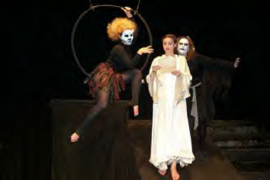
Hecate, queen of the witches, yells at the three witches for not asking her permission the first time they met with Macbeth. Now, they have her permission to deal with him. He will be there soon, asking more questions. The witches and Hecate laugh at what they’ve done to Macbeth…they’ve made him OVERCONFIDENT! That is the worst downfall a human can have!

Slide 38
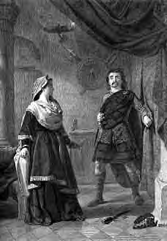
In the meantime, Macbeth must get some sleep. He’s suffering from sleep deprivation.
Macbeth tells his wife that it’s too late for them to turn back. Even if they could, they have waded into blood so deeply, that it would be just as easy to keep on going (kill more people) as it would to turn around and try to go back (of course, it’s impossible to give back the lives of the people he has killed).

Slide 39
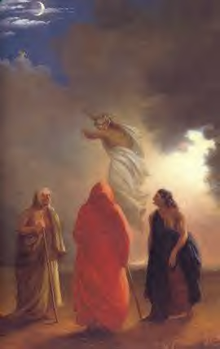
We don’t think Shakespeare wrote Act III, Scene 5…we think that a printer named Thomas Middleton wrote it. Middleton was the printer who printed Shakespeare’s First Folio after his death. Middleton loved the subject of witches and wrote his own play called The Witch. He probably added this scene and a few touches in other places where the witches appear.

