Slide 1
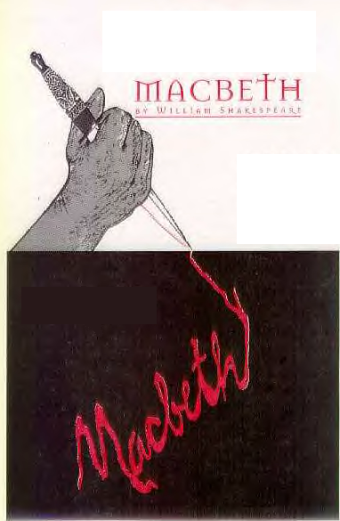
Act Four
Act One
Scene One

Slide 2
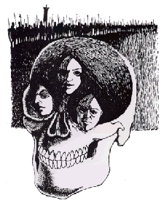
In a cave, the three witches are stirring up an evil brew as Macbeth enters. He tells them they must answer his questions.

Slide 3
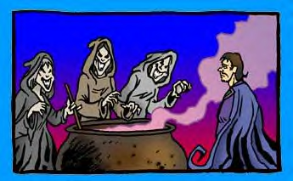

Slide 4
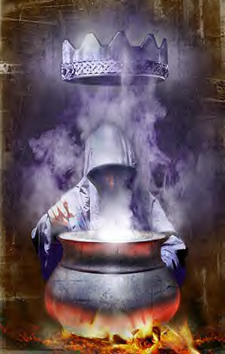
They show him three apparitions. The first is an armed head which tells Macbeth that he must beware Macduff.

Slide 5
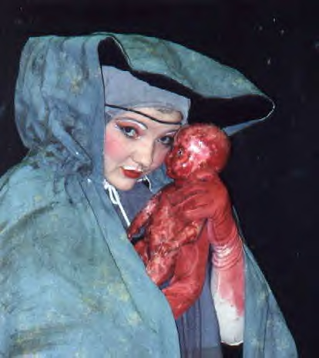
The second is a bloody child that says none born of woman may harm Macbeth.

Slide 6
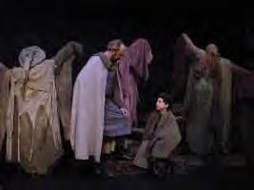
The third apparition is a crowned child which says that Macbeth cannot be conquered until Dunsinane Hill shall come against him.

Slide 7
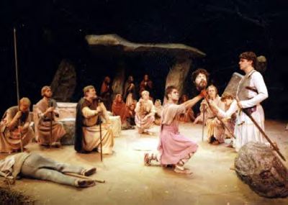
The apparitions of 8 kings then pass before Macbeth’s eyes followed by the ghost of Banquo. The witches vanish and Lennox returns reporting that Macduff has fled to England. Macbeth decides that Macduff’s castle should be attacked and his family killed.

Slide 8
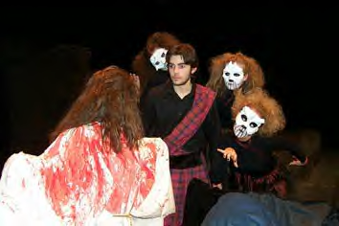
Act IV Scene II

Slide 9
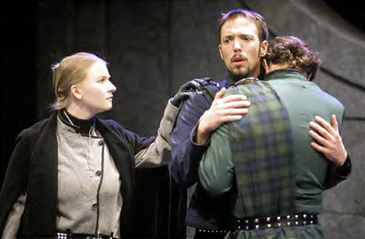
jkjkjk
Ross is comforting Lady Macduff who does not understand why her husband has left. Ross cannot tell her why but does tell her it was for a wise reason. He leaves and she then begins to have a conversation with her son who is wise beyond years.

Slide 10
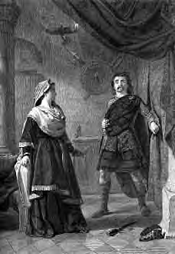
A messenger interrupts tell them to leave quickly. The murderers arrive calling Macduff a traitor. Macduff’s son is killed protecting his mother who then flees.

Slide 11
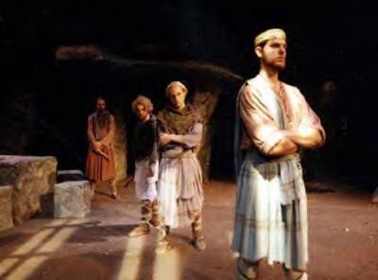
Macduff tell Malcolm in England the sorry state Scotland is in. Malcolm does not trust him to begin with. They test one another verbally and eventually trust each other. Siward has raised army to fight Macbeth and wants Macduff to join him.

Slide 12
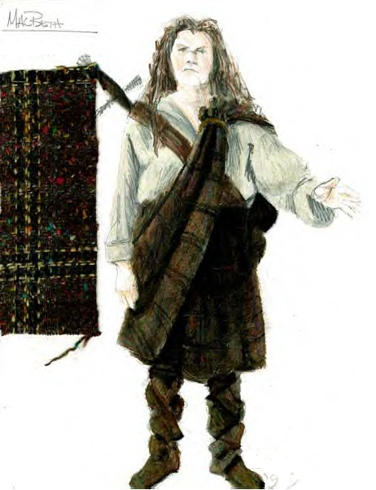
Ross enters and tells Macduff his family and servants have been murdered. Macduff blames himself. He vows to take revenge. Malcolm says they will go to King Edward and then depart for Scotland.

Slide 13
Act Five
Scene One

Slide 14
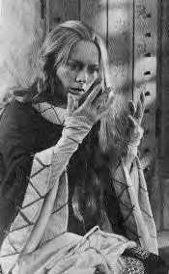
It is reported to the doctor that Lady Macbeth has begun sleepwalking. At that moment she appears sleepwalking and going through the motion of washing her hands. She is constantly speaking of blood.

Slide 15
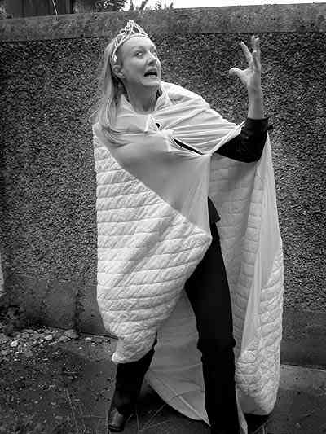
She also refers to Duncan, Banquo and Lady Macduff. The doctor recognizes what this means but tells her handwoman to keep her safe and that she needs God;s help.

Slide 16
Act V Scene II

Slide 17
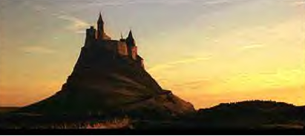
Near Macbeth’s castle in Dunsinane, the nobles have gathered with the English forces. Siward, Malcolm, and Macduff will lead the assault from Birnam Wood. It is reported that Macbeth is fortifying his castle.

Slide 18
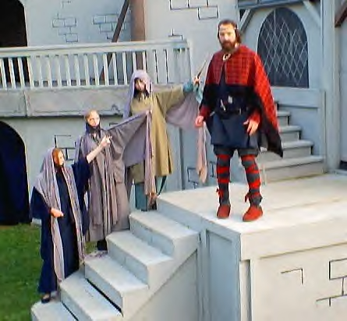
Some say that Macbeth is insane while others that he is in a fury. He has no loyal supporters. The nobles depart to join Malcolm.

Slide 19
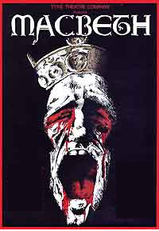
Act V Scene III

Slide 20
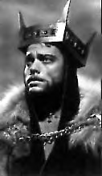
Macbeth is bolstering his courage by repeating the predictions made to him by the witches. A servant reports that a huge army is approaching. The doctor reports Lady Macbeth has a troubled mind which cannot be cured. Macbeth says he wishes Scotland could be purged of English troops. The doctor wishes he were somewhere else.

Slide 21
Act V Scene IV

Slide 22
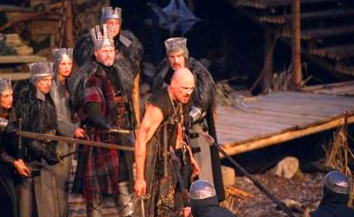
The Scottish nobles gather near Birnam Wood. Malcolm suggests each soldier cut a branch from a tree and carry it as camouflage so they cannot be detected until they get closer to the enemy.

Slide 23
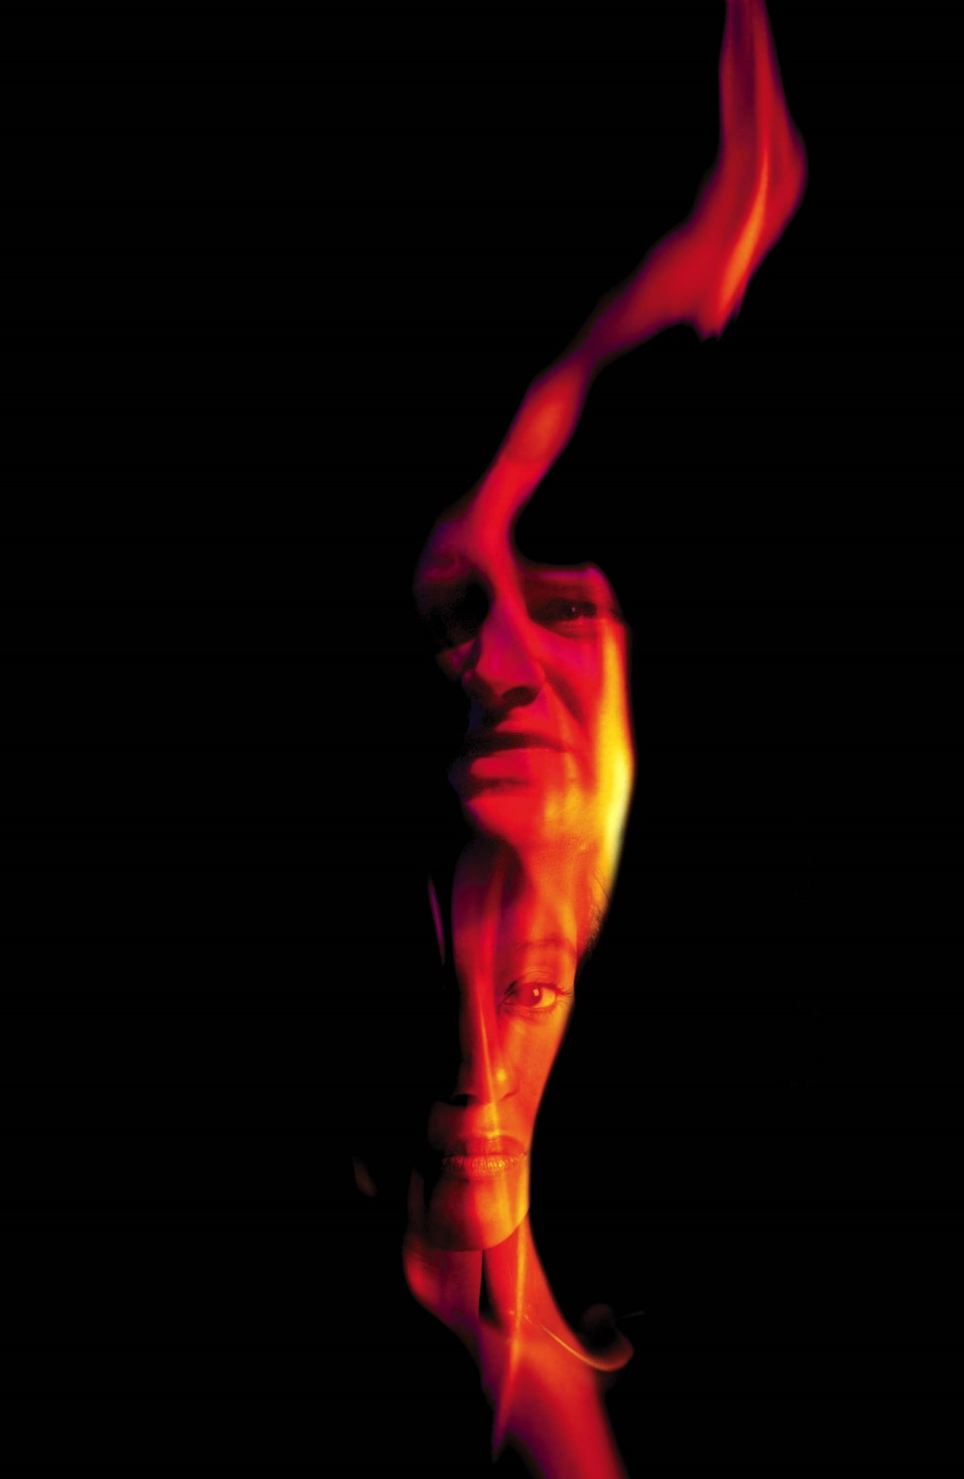
Act V Scene V

Slide 24
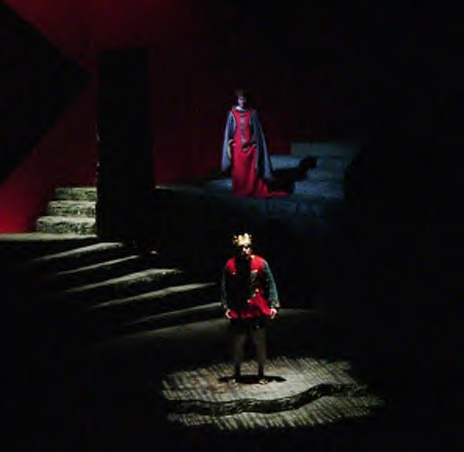
Macbeth is certain his castle can’t be taken so he prepares for a siege. Word comes that Lady Macbeth is dead by leaping from the top of the castle. Macbeth expresses his despair.

Slide 25
A messenger brings Macbeth some strange news: Birnam Wood seems to be moving toward the castle. Macbeth remembers the apparitions words and prepares to fight although he is hopeless.

Slide 26
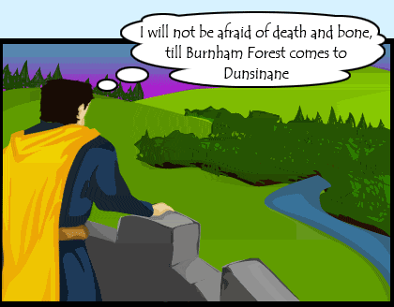

Slide 27
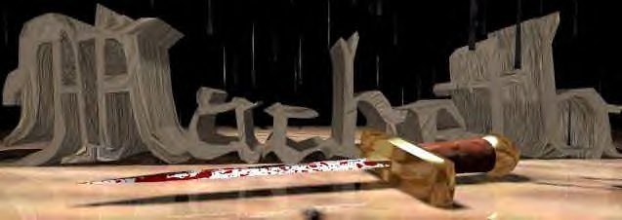
Act V Scene VI
Malcolm tells his forces to throw down their branches. He then deploys his soldiers for battle.

Slide 28
ACT V Scene VII
Young Siward encounters Macbeth and is killed. Macduff searches for Macbeth ready to exact his revenge.

Slide 29
Act V Scene VIII The Final Scene

Slide 30
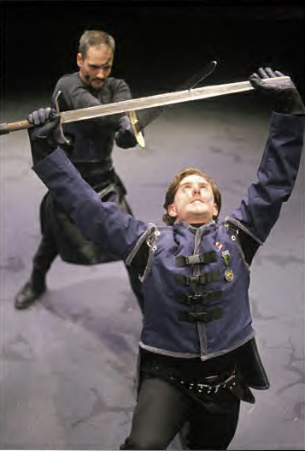
Macbeth has considered suicide but rejects the idea. He meets Macduff but refuses to fight him and tells him of the prophecy that he can’t be killed by anyone born of woman.

Slide 31
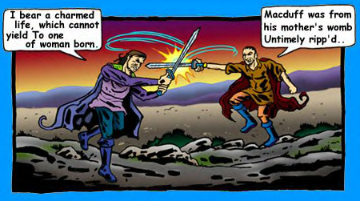

Slide 32
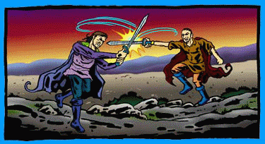
They begin the battle while the action shifts to Malcolm and Siward.

Slide 33
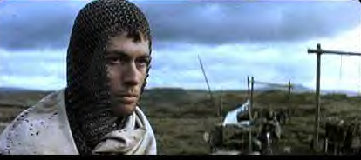
Malcolm and Siward have been victorious but Siward learns his son was killed in battle. He is told by Ross he died a hero’s death which made his father proud. Macduff then appears carrying………..

Slide 34
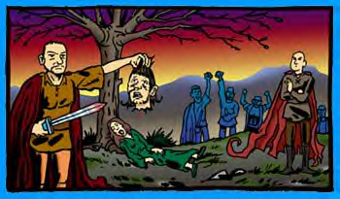
Macbeths’ head!!! He hails Malcolm as King of Scotland who then promises to reward those loyal to him and punish those who supported Macbeth.

Slide 35
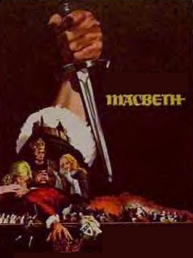
The End!!!

